Slide 1
Lecture 6c: A Complete Datapath
To watch lecture video click link below
Lecture 6c video
To view slides, continue to next slide

Slide 2
Lecture 6c: A Complete Datapath
For a subset of MIPS Instructions

Slide 3
The Processor: Datapath
We have built up datapath for each of the following instructions separately
arithmetic-logical instructions: add, sub, and, or
memory-reference instructions: lw, sw
control flow instructions: beq
Now we’d combine these datapaths to form a complete datapath for the processor
Use MUX (multiplexor) to split or join paths
MUX: multiple inputs, based on the control value, one, and only one of the inputs will pass through the MUX and become the output.
So each instruction is able to find its own way on the datapath by controlling MUX to appropriate setting.

Slide 4
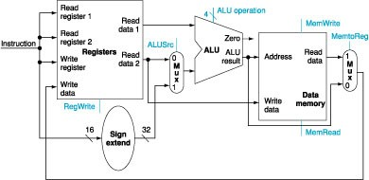
Combining lw&sw with R-type
MUX1 (controlled byALUSrc): for R-type ReadData2 will pass through it; for lw & sw, the sign extended value will pass through it; i.e. the 2nd input to ALU will be either ReadData2 (R-type) or sign extended value (lw/sw);
MUX2 (controlled by MemtoReg): For R-type the ALU result (bypass DM) will be the WriteData for Registers, for lw the ReadData from DM will be the WriteData for Registers.

Slide 5
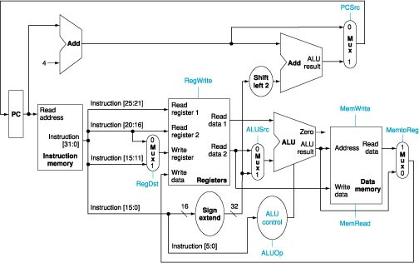
The Complete Datapath
Details on how to form the complete datapath will not be further discussed here.

Slide 6
Now we’d trace/verify if the complete datapath does work for these instructions. Critical path: the part of the datapath significant to the execution of the instruction.
R-type (and, or, add, sub)
lw
sw
beq

Slide 7
The Complete Datapath
Details on how to form the complete datapath will not be further discussed here.

Slide 8
R-type
The highlighted is the execution path for R-type instructions. Here we not consider the input to the ALU control unit yet.

Slide 9
lw

Slide 10
sw

Slide 11
beq
Result of ALU affects the control of this MUX

Slide 12
Summary
Single cycle implementation
Components and connections of datapath
Able to trace the datapath for each instruction
Thinking Question:
How to include addi on the datapath?
What’s ahead
Control design

